Slide 1
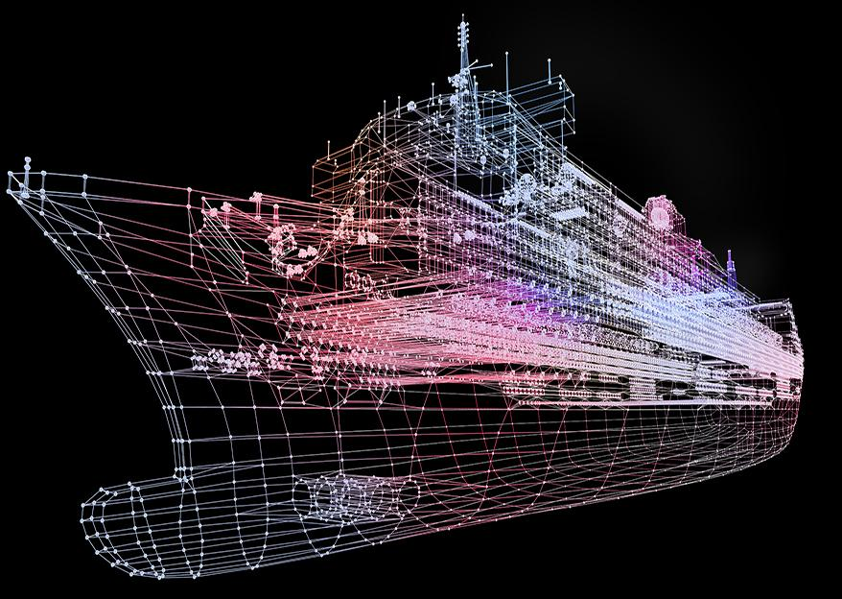
SHIP CLASSIFICATION USING TRIPLET CNN
Guided by,
Submitted by,
ABIN K JAYAN ADR18CS001
AJMAL LATHEEF ADR18CS003
ASHIL JOHNSON ADR18CS014
SIDDHARDH R NAIR ADR18CS038
Mrs. Manju J
Assistant Professor
Dept. of Computer Science

Slide 2
CONTENTS
AIM
INTRODUCTION
SYSTEM DESIGN
USE CASE DIAGRAM
DFD
LEVEL 0
LEVEL 1
LEVEL 2
LEVEL 3
USER INTERFACE IMAGES
GANTT CHART
MODIFICATION
FUTURE SCOPE
CONCLUSION
REFERENCES

Slide 3
AIM
To develop Ship classification from SAR images using special Triplet deep learning model

Slide 4
INTRODUCTION
The purpose of ship classification is to identify various types of ships as accurately as possible, which is of great significance for monitoring the rights and interests of maritime traffic and improving coastal defense early warnings.
With the improvement of all kinds of imaging technology, the ship classification method of imaging technology has become the mainstream method of ship target classification and recognition.

Slide 5
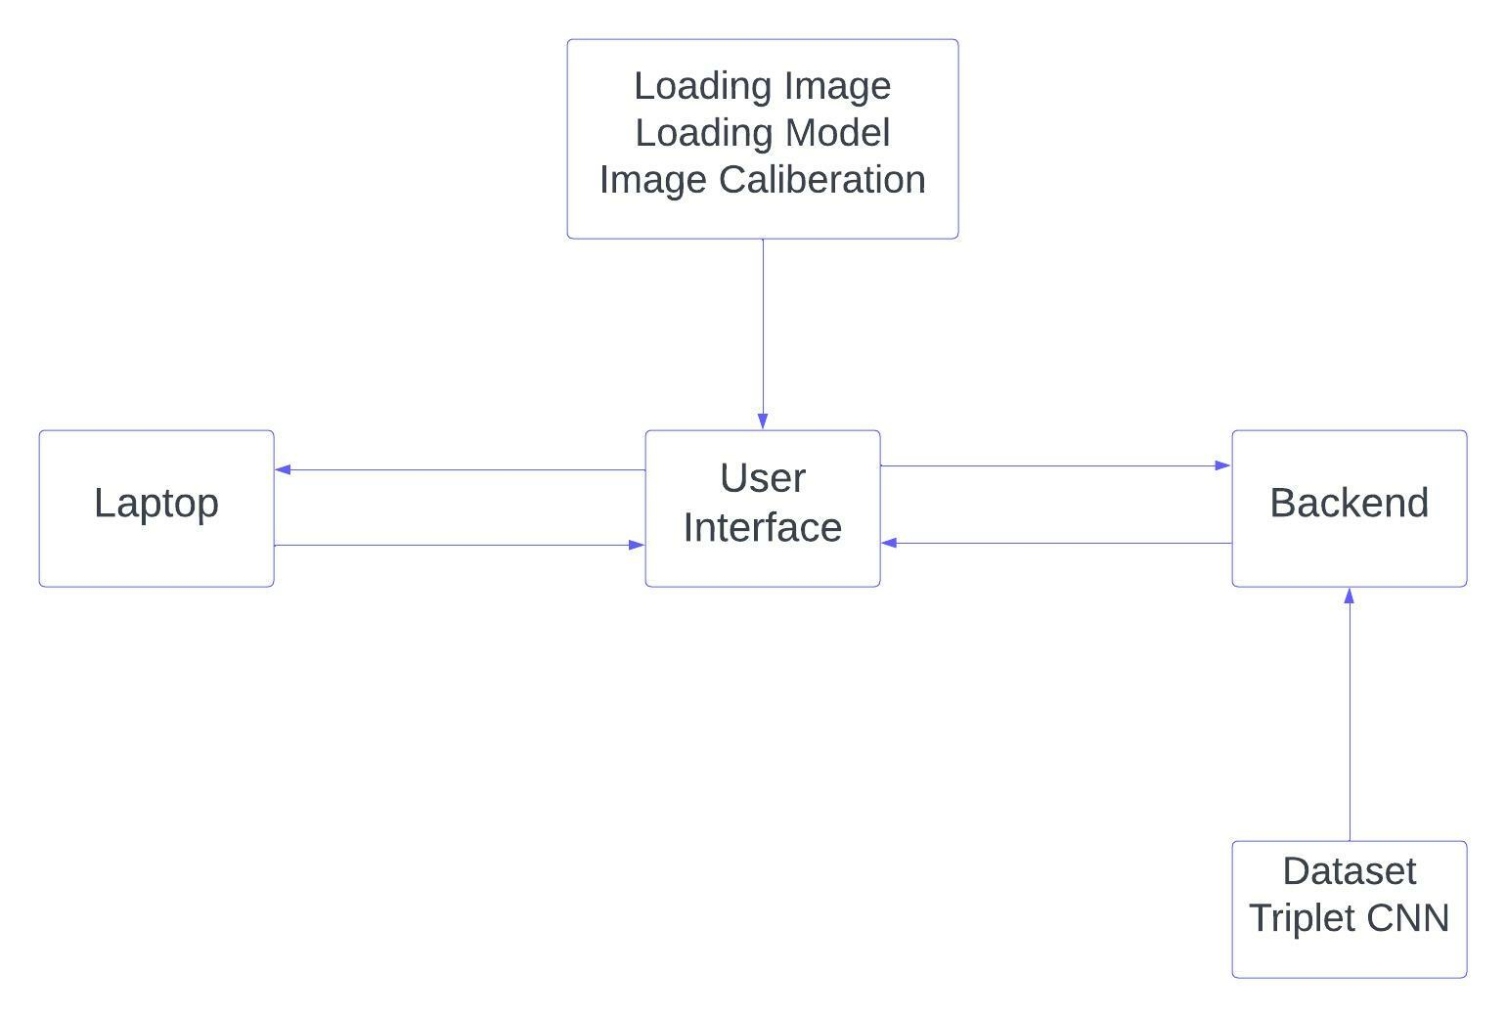
SYSTEM DESIGN

Slide 6
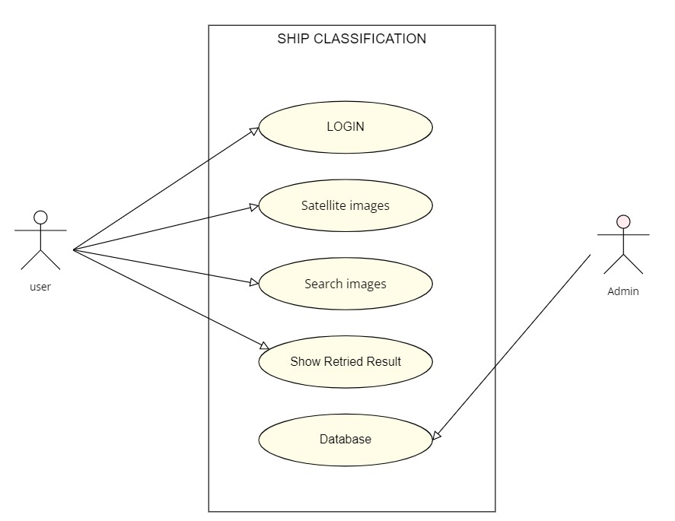
USE CASE DIAGRAM

Slide 7
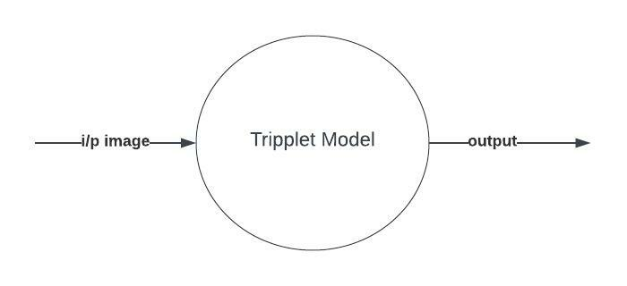
DFD-Level 0

Slide 8
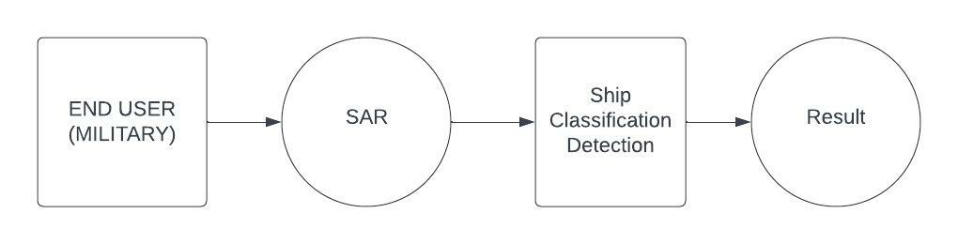
DFD-Level 1

Slide 9
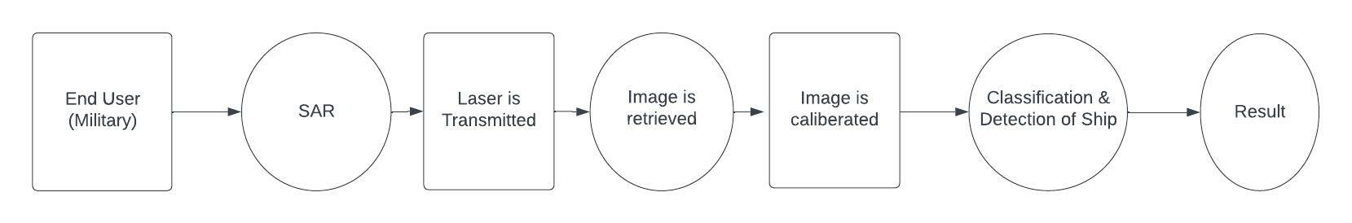
DFD-Level 2

Slide 10
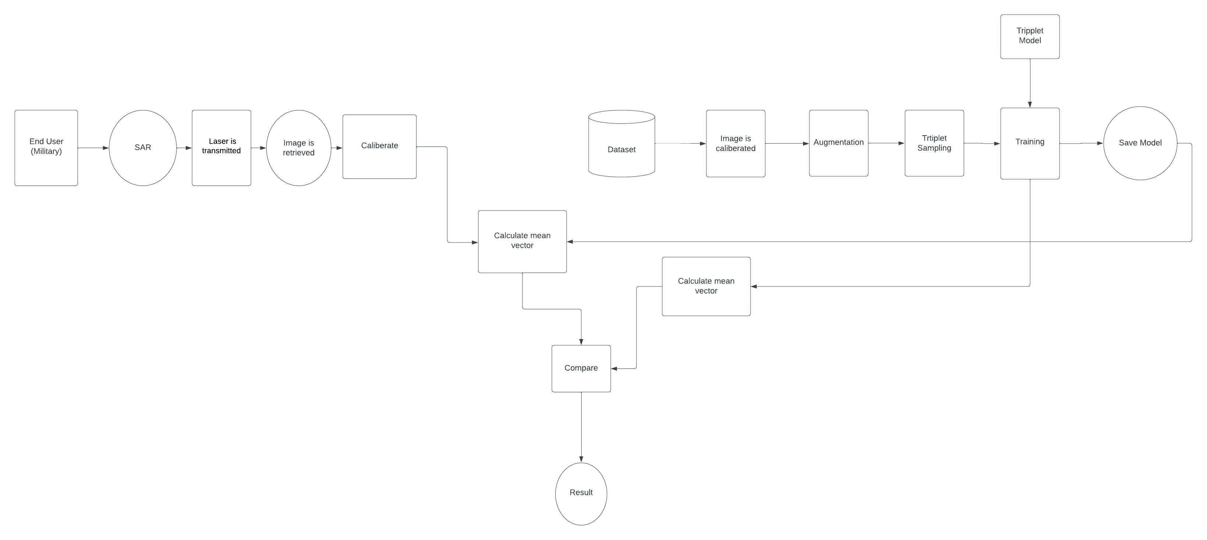
DFD-Level 3

Slide 11
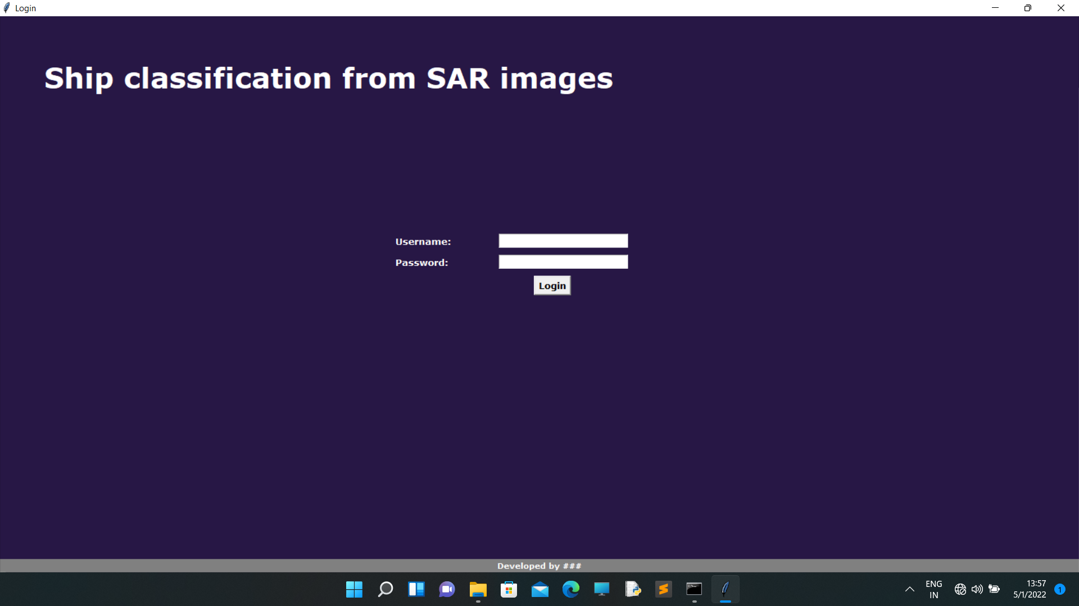
USER INTERFACE

Slide 12
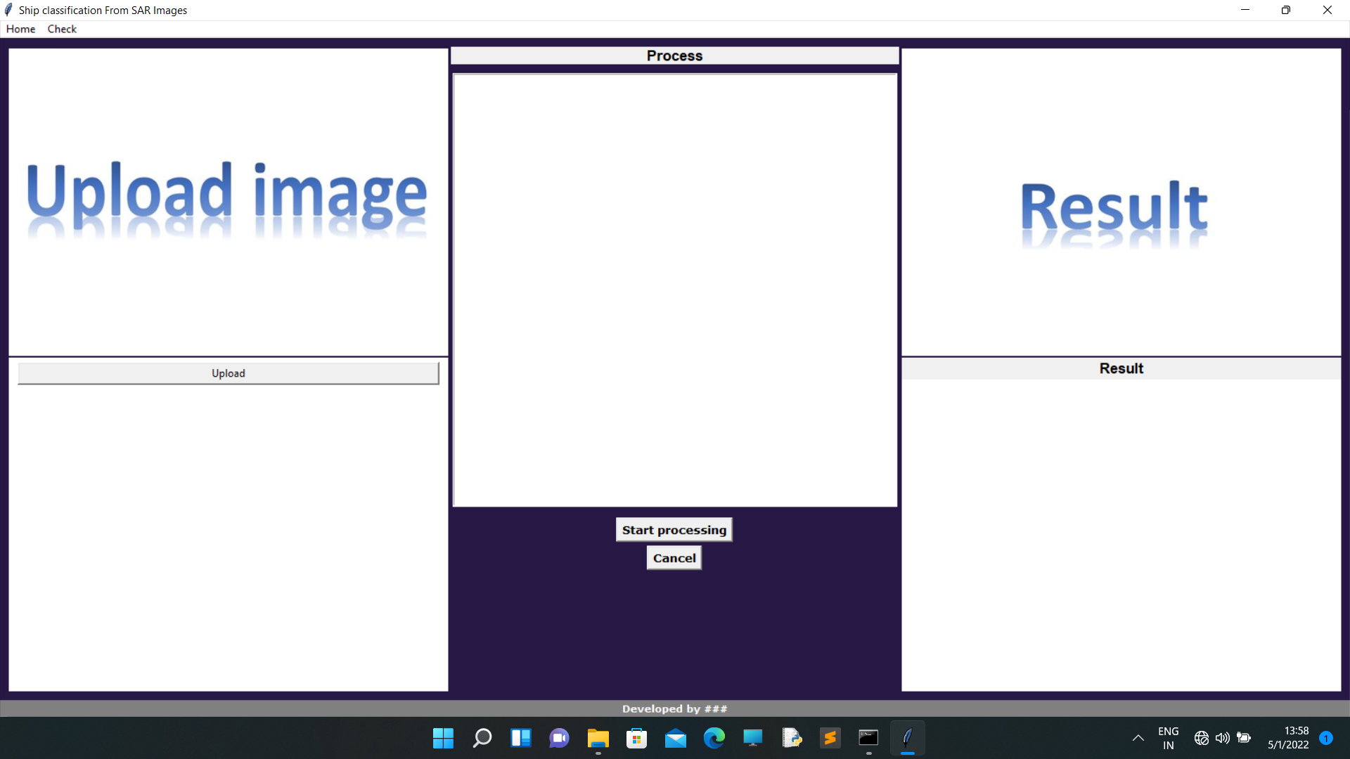

Slide 13
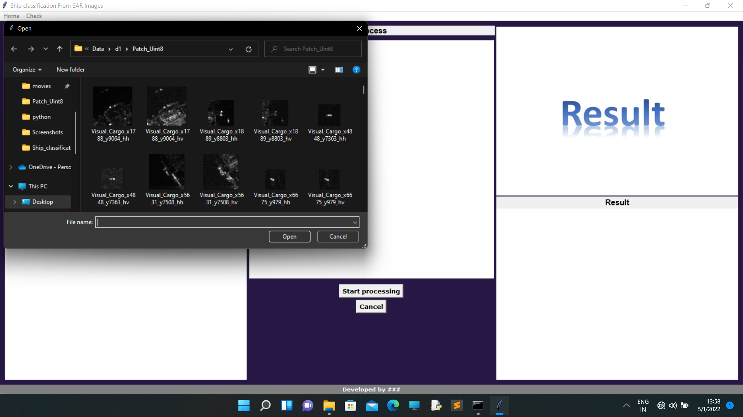

Slide 14
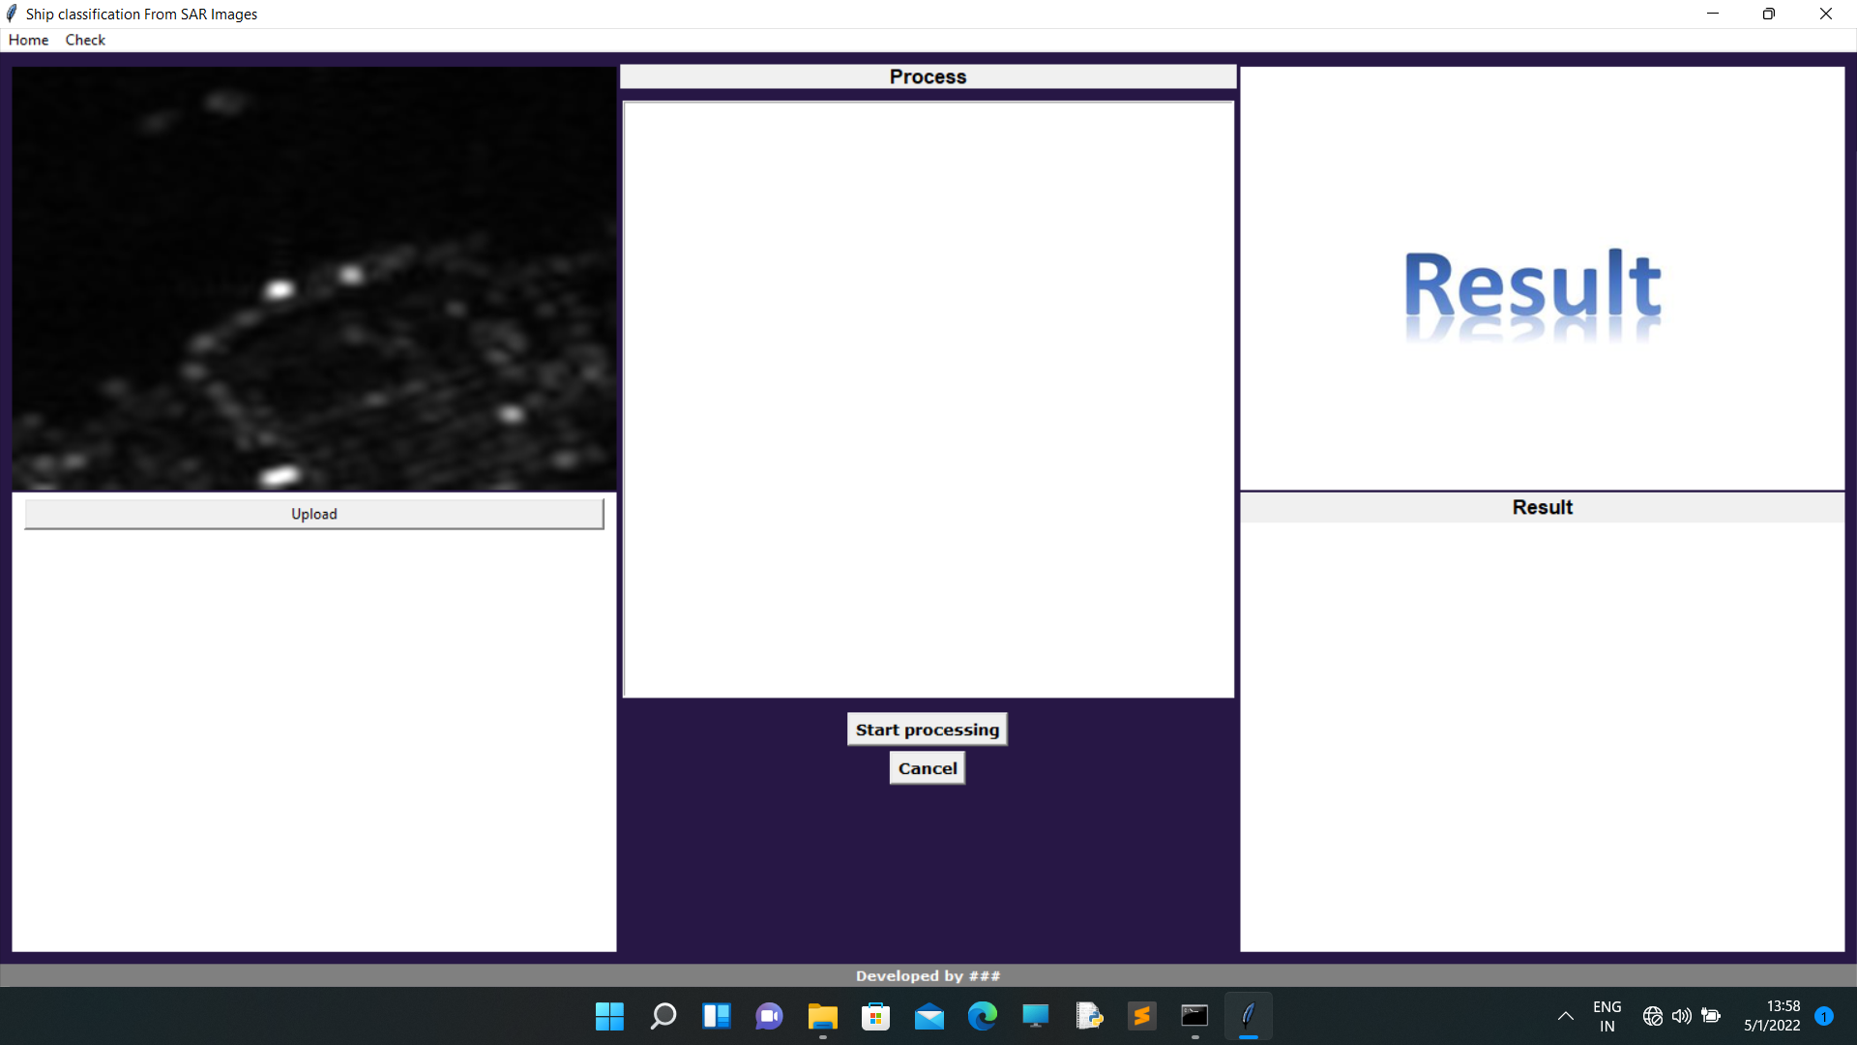

Slide 15
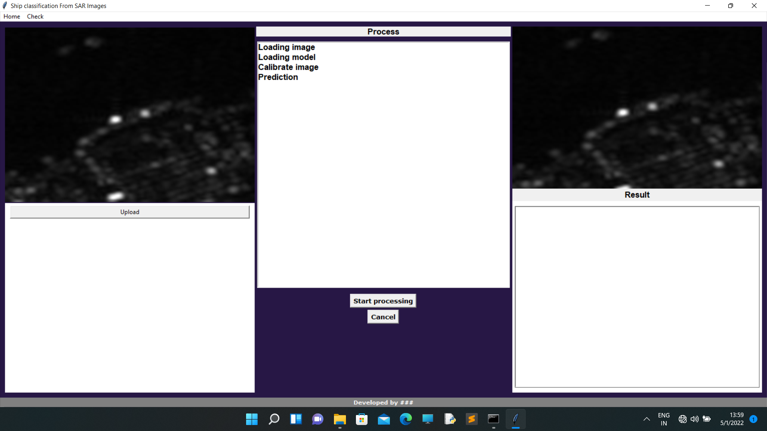

Slide 16


Slide 17
GANTT CHART

Slide 18
MODIFICATION
Comparing our machine with other machines which have different algorithm.
Those algorithms are
CNN
ResNet
Accuracy achieved by using each algorithms are obtained and the highest among will be the one having Triplet CNN algorithm

Slide 19
FUTURE SCOPE
Simplification of code
Enhancement of user interface

Slide 20
REFERENCES
https://github.com/mbadamve/deep-learning-ship-classification
https://github.com/xxczaki/ship-classifier
https://www.youtube.com/watch?v=50cBvizRuM0

Slide 21
CONCLUSION
The existing system classify ships from normal images using normal CNN
The proposed system improved ship classification by introducing special Triplet deep learning model.

Slide 22
THANK YOU

